Slide 1




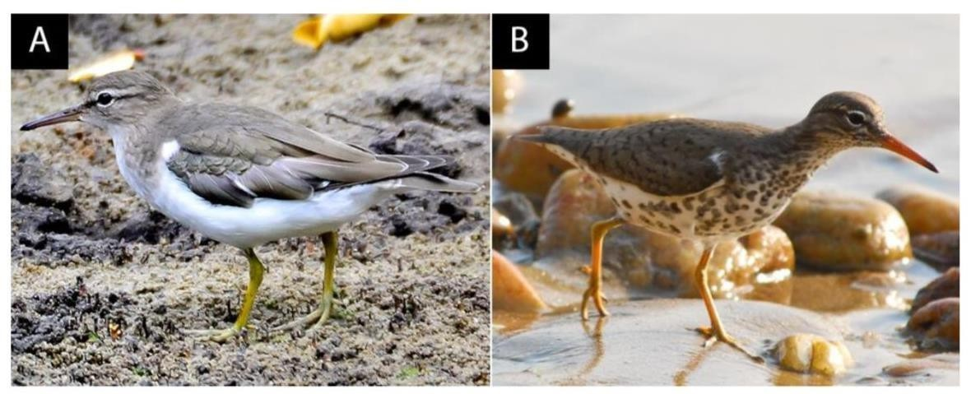






Characterization of Choristoneura fumiferana Granulovirus in the Virome of Actitis macularius During Wintering in the Coastal Amazon.
Isabela de Campos Freire (IFPA); Patrick Douglas Corrêa Pereira (McGill University); Mauro André Damasceno de Melo (IFPA); Cristovam Guerreiro Diniz (IFPA); Nara Gyzely de Morais Magalhães (IFPA)
Author: isabeladecamposfreire@gmail.com
THEMATIC AREA AND ODS
MATERIALS AND METHODS
Baculoviridae Family: More than 600 species of viruses that infect arthropods, with circular double- stranded DNA genomes. Divided into four genera: Alphabaculovirus,,Betabaculovirus,Gammabaculovir us, and Deltabaculovirus.
Choristoneura fumiferana granulovirus is a
FIELD OF KNOWLEDGE/SUBFIELD: Area 2 –
Genetics: ODS15 – Terrestrial life.
Sampling
INTRODUCTION
Wild birds that undertake long-distance migrations act as vectors for microorganisms, which can undergo mutations and recombinations, potentially leading to outbreaks of diseases in animals or humans (Yin et al., 2017). One of the species found in the Bragantina region that migrates long distances is Actitis macularius, which belongs to the order Charadriiformes and the family Scolopacidae. These birds leave their breeding sites in Canada during periods of food scarcity and low temperatures and migrate to tropical regions (Blizard; Pruett-Jones, 2017).
Sampling at Praia de Pilão using mist nets at three points during dusk.
Betabaculovirus specific to lepidopterans.
Anesthesia and Perfusion
Betabaculovirus hymenopterans
are natural enemies of and lepidopterans, used as
Anesthesia with isoflurane.
Transcardiac perfusion with saline solution.
biological control agents in agriculture and forestry (Kemp; Woodward; Cory, 2011).
Virus host: the Choristoneura fumiferana caterpillar, one of the most destructive species in North America, causing significant damage to coniferous trees (Bah et al., 1997).
The virus is utilized in integrated pest management programs to control C. fumiferana caterpillars (Forté; Guertin; Cabana, 2012).
The virus has been detected in Calidris pusilla, in overwintering migratory birds in China, as well as in other organisms such as lancelets, ticks, and mosquitoes, but there are no records of its presence in the Amazon (Du et al., 2023; Gangopadhayya et al., 2024; Liu et al., 2024; Pereira et al., 2023).
Migratory birds like A. macularius and C. pusilla may have acquired the virus during the breeding period in North America, as the host species does not occur in the Amazon.
There are no reports in the literature of diseases caused by this virus in humans or other vertebrate animals.
Craniotomy
Removal of the brain followed by the separation of the telencephalon.
RNA extraction.
Standard TRIzol™ protocol.
Sequencing
Ion 540 chip and Ion S5 GeneStudio System for FASTQ file production.
Filtering
FastQC for quality analysis of sequences and filtering with Trimmomatic 0.36.
Figure 1 – Actitis macularius. (A) Non-breeding plumage. (B) Breeding plumage.
Viral Identification
The understanding of viral diversity in birds is limited. Monitoring viral diversity in wildlife, especially in birds that act as hosts, is crucial to preventing future emerging epidemics (Fernandez- Correa et al., 2019), and the use of metagenomic techniques, such as next-generation sequencing (NGS), allows for the broad identification and study of both known and highly divergent viruses (Shan et al., 2022). This technique enables the study of the genome of birds that may serve as virus reservoirs (Vibin et al., 2020). Given the importance of identifying viruses in wild birds and understanding their role in the spread of diseases, this study aims to describe the Choristoneura fumiferana granulovirus found in the transcriptome of Actitis macularius birds during their wintering in the Coastal Amazon.
Scanning for viruses using the VIRTUS2 pipeline. Reference genome and transcriptome of Calidris pugnax.
NCBI Viral Genomes Ref-Seq database.
CONCLUSION
The virus carried by A. macularius and other migratory birds to the Amazon poses no risk to human health. Future studies should investigate the presence of this virus in other migratory birds and the potential impacts of its spread.
RESULTS AND DISCUSSION
The sequencing of the metavirome identified 626 viruses in the transcriptome of Actits macularius, with the Choristoneura fumiferana granulovirus presenting the highest number of reads.
Table 1 – Information on Choristoneura fumiferana granulovirus, the virus with the highest number of reads in the neurotranscriptome of A. macularius.
REFERENCES
UNIQ ID | Num reads | Cov bases | Cove rage | Rate_hit
NC_008168.1 | 81445 | 183 | 0.174768 | 0.001001597
UNIQID: Unique GenBank identifier for each virus sequence; Numreads: The number of reads that mapped to this region of the viral genome; Covbases: Total number of bases of the genome covered by the reads; Coverage: Percentage of the viral genome covered by the reads; Rate_hit: Detection rate that reflects the relative frequency of virus detection in relation to the total number of sequences analyzed.

